Slide 1
PowerGraph: Distributed Graph-Parallel Computation on Natural Graphs
Authors: Josepth E. Gonzalez, Yucheng Low, Haijie Gu, Dany Bickson, Carlos Guestrin
Presented by: Mengqiu Teng, Shenghao Lin, Ying Luo

Slide 2
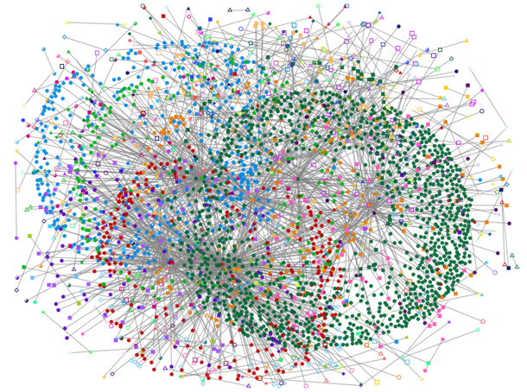
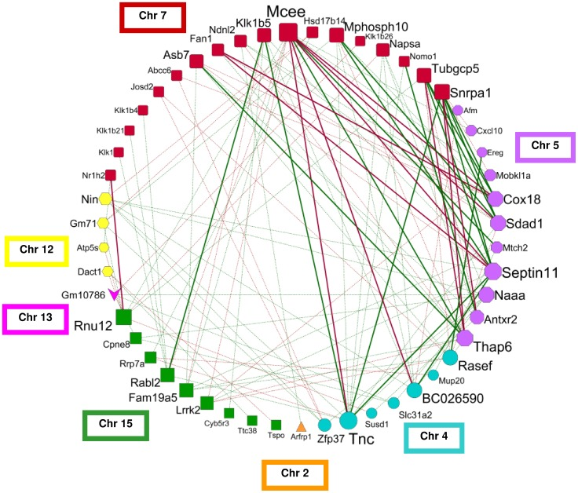
Background: Natural Graphs
Graphs generated from natural phenomena.
Essential to data mining and machine learning
Find influential people, detect function of proteins, advertising
Facebook Friend Relationship
Chromosome Interaction
Notes:
Large, of course needs parallel computing

Slide 3
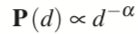
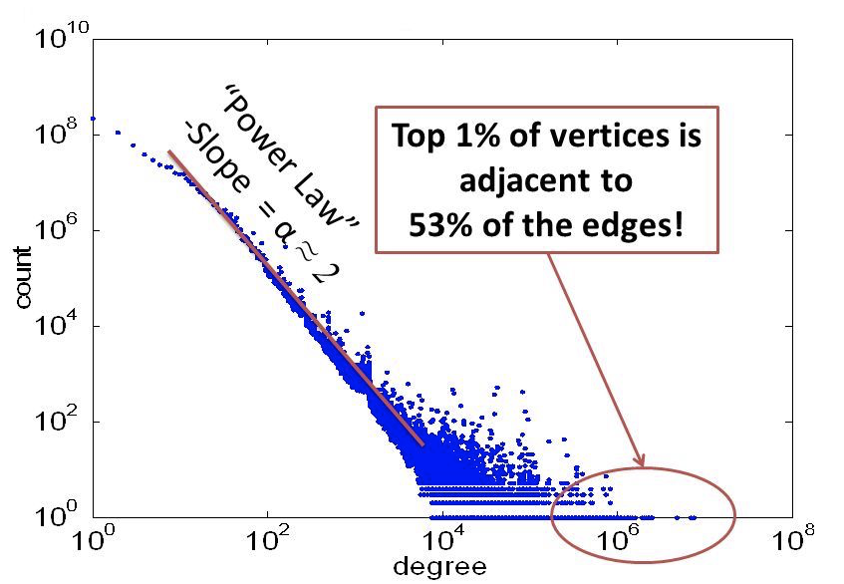
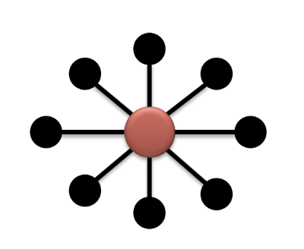
Background: Power Law
High skewed distribution which is hallmark property of natural graphs.
, probability a vertex has degree d
Altavista Web Graph: 1.4B Vertices, 6.7B Edges
Star Motif

Slide 4
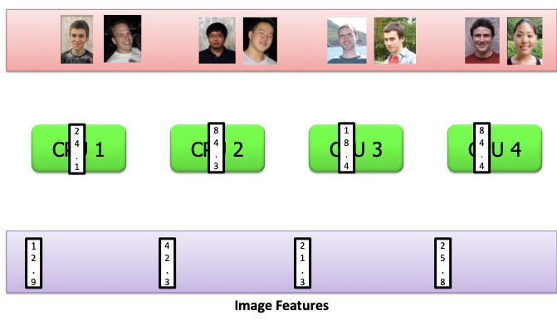
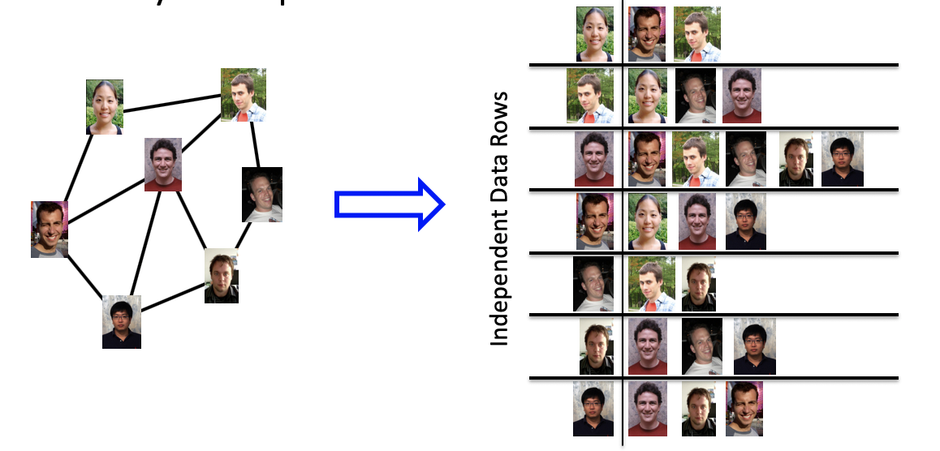
Background: Mapreduce in Graph
Hard to partition.
Notes:
Large, of course needs parallel computing

Slide 5
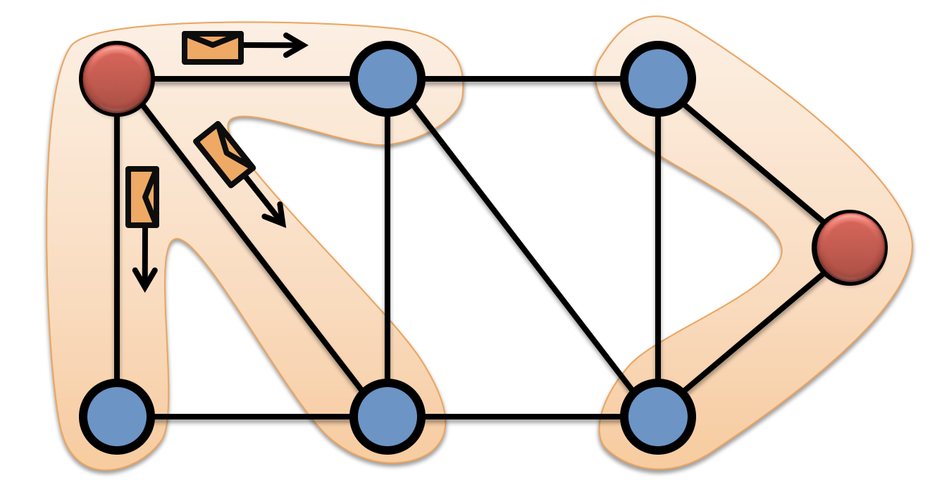
Background: Graph-Parallel Abstraction
Vertex-program Q executed in parallel

Slide 6
Background: Graph-Parallel Abstraction
Interactions limited along edges
Messages (Pregel)
Shared State (GraphLab)

Slide 7
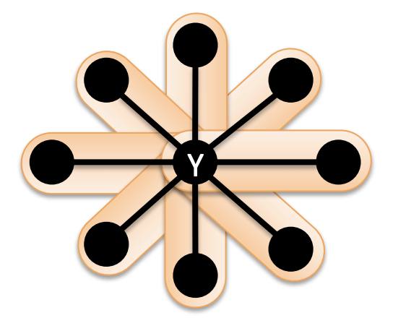
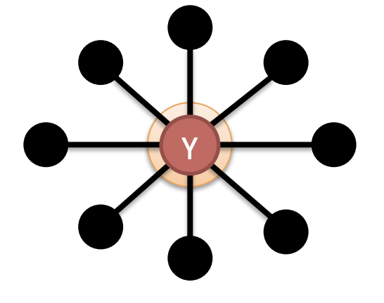
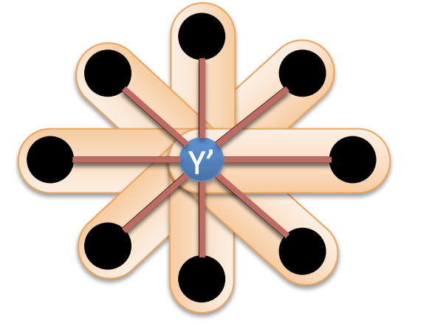
Background: Graph-Parallel Abstraction
GAS model: Gather, Apply, and Scatter
Gather Information about Neighborhood to get an accumulated value
Apply accumulated sum
Scatter new central value to update neighbors

Slide 8
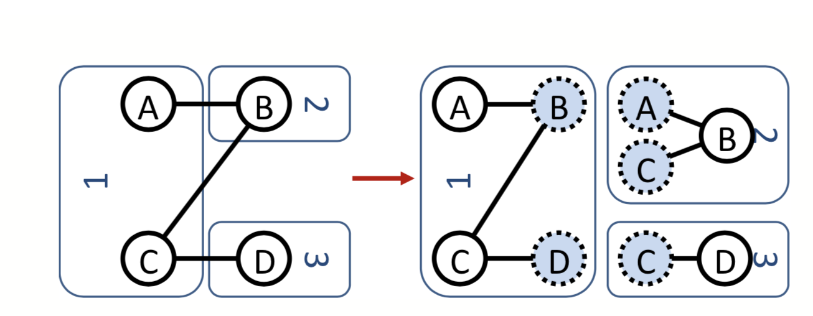
Background: Existing Framework Problems
Key Problem: Performs edge-cut instead of vertex-cut.
Performs edge-cut where vertices are uniformly distributed among machines and edges that span over multiple machines are minimized.
Edge cut

Slide 9
Background: Existing Framework Problems
Key Point: Performs edge-cut instead of vertex-cut.
Performs poorly on power graph. => Perform random partition of vertices.
Poor Locality!

Slide 10
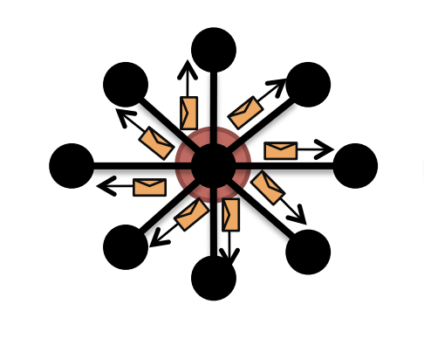
Background: Existing Framework Problems
Key Point: Even distribution of vertices.
Work Imbalance.
Identical messages in communication.

Slide 11
Background: Existing Framework Problems
Key Point: Even distribution of vertices.
Required memory linear to degree of node.
Storage problem for high-degree nodes.

Slide 12
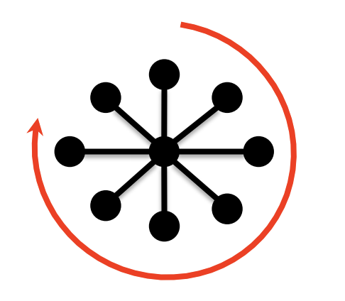
Background: Existing Framework Problems
Key Point: Even distribution of vertices.
Sequential execution of individual vertex-program.
Reduces parallelism and limits scalability.

Slide 13
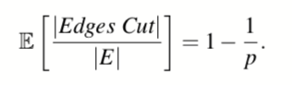
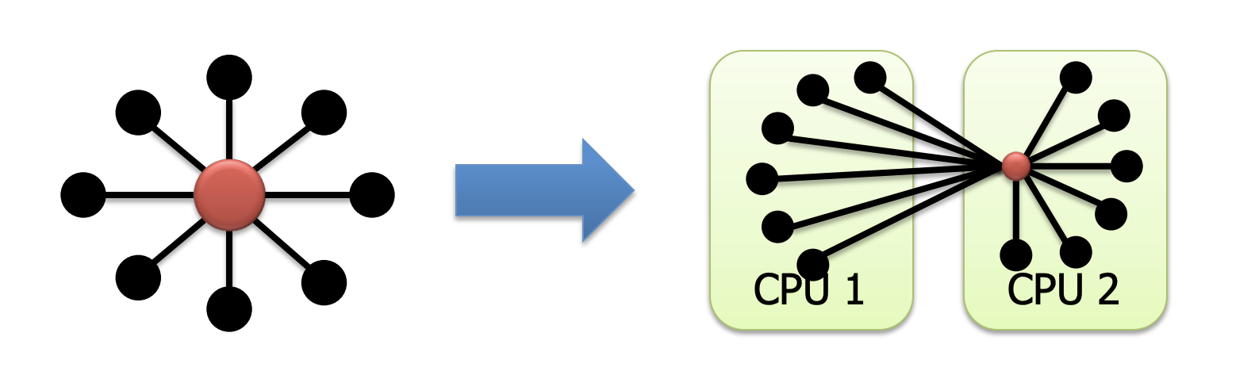
Background: Existing Framework Problems
Key Point: Performs edge-cut instead of vertex-cut.
Most edges are cut. (90% cut for 10 machines, 99% cut for 100 machines)

Slide 14
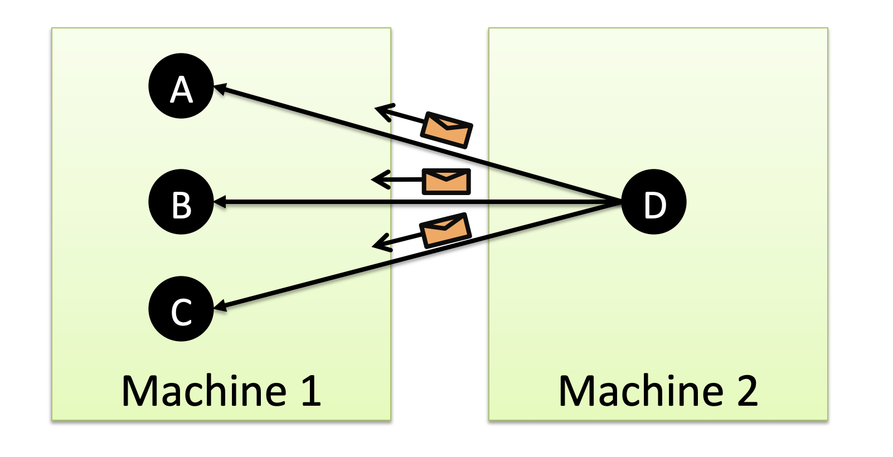
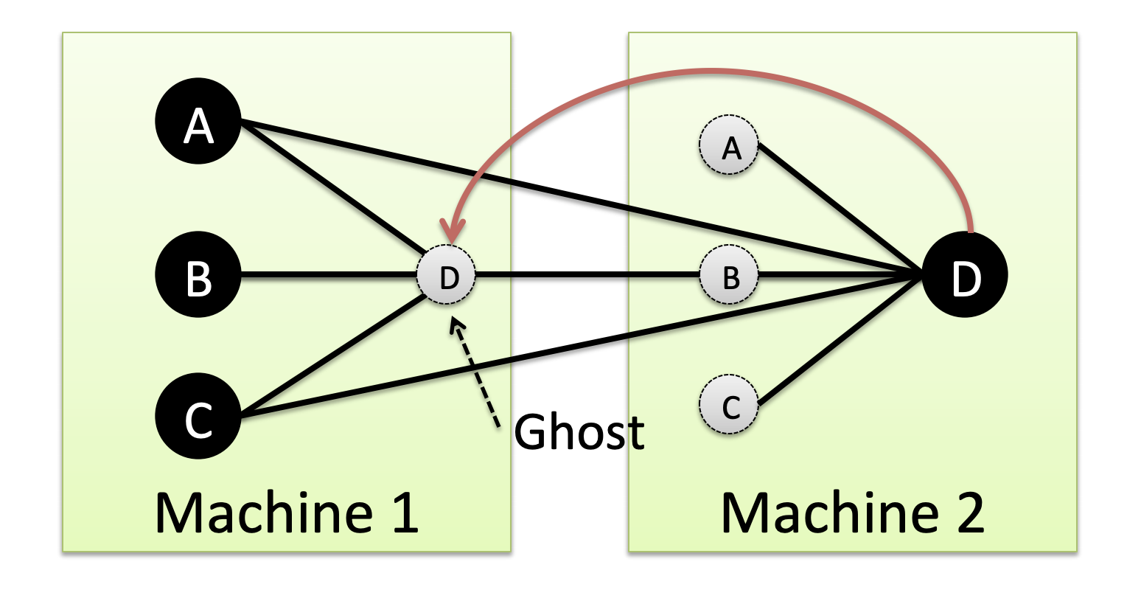
Background: Existing Framework Problems
Key Point: Performs edge-cut instead of vertex-cut.
Ghost edges or vertices are created due to cut of edges.
Storage and communication overhead.

Slide 15
Solution: PowerGraph!
Combines abstraction from Pregel and GraphLab frameworks.
Use vertex-cut instead of edge-cut.

Slide 16
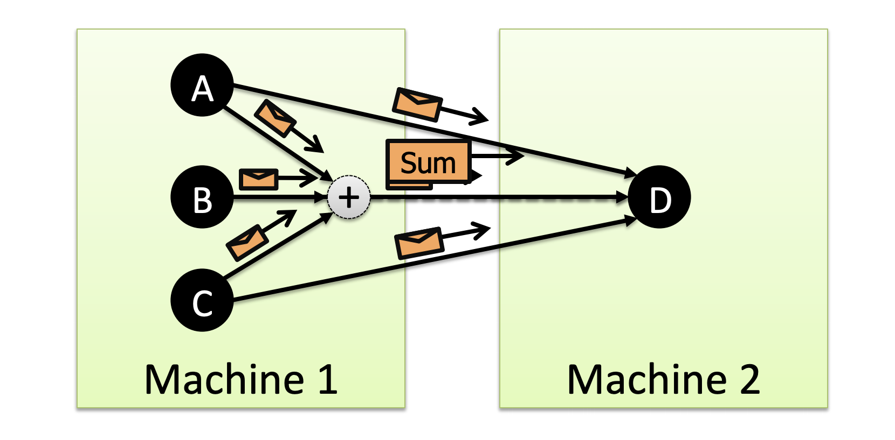
PowerGraph Abstraction
Uses user-defined, commutative, associative gather concept(combiner) from Pregal.
Reduce communication.

Slide 17
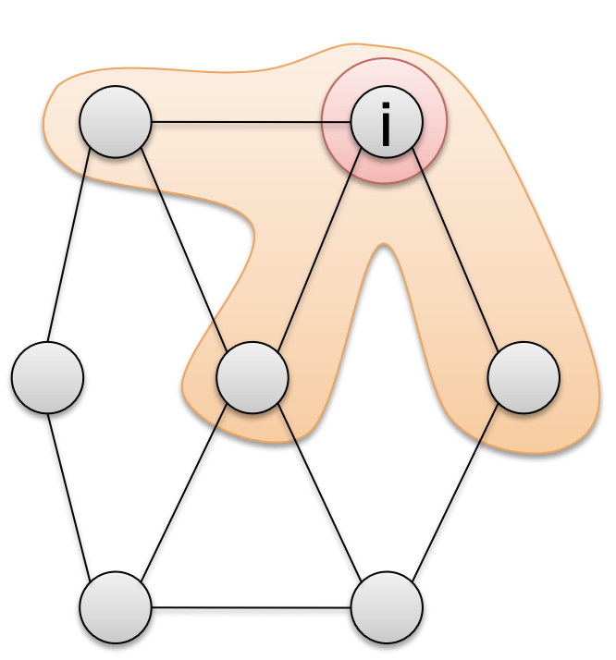
PowerGraph Abstraction
Data-graph and shared memory from GraphLab.
Eliminate user architecture for data movement.

Slide 18
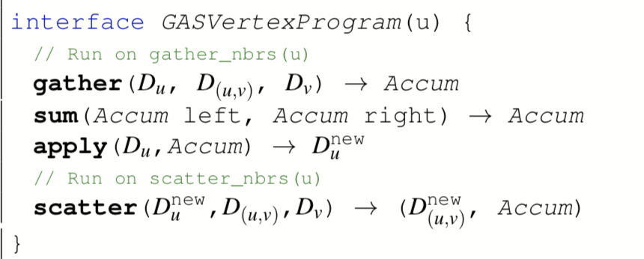
PowerGraph Abstraction
GAS Vertex-Program Interface: gather, sum, apply and scatter

Slide 19
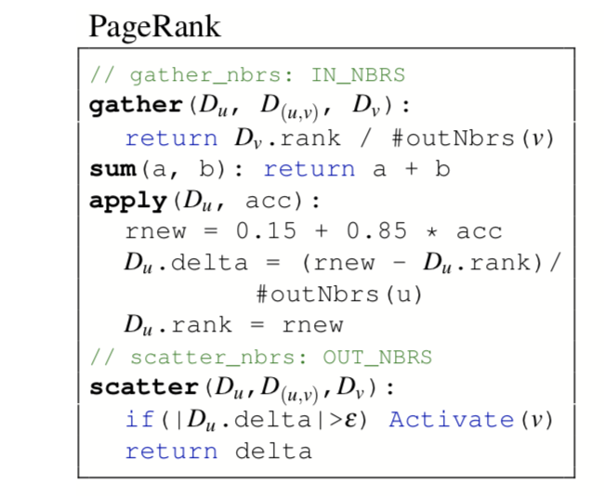
PowerGraph Abstraction
GAS Vertex-Program Interface: gather, sum, apply and scatter

Slide 20
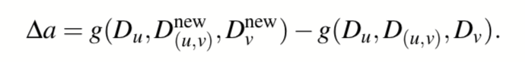
PowerGraph Abstraction
Delta Caching
Maintain a cache of accumulator
Provide correlation on-top of previous gather for that edge

Slide 21
PowerGraph Abstraction
Active Vertices: where vertex-program are eventually executed
Initiates through: Activate(v), Activate_all()
Can only activate vertices visible in the argument to that function.
(u, v) can only activate u, v.
Order in execution up to engine but will eventually be executed.
Synchronously or asynchronously

Slide 22
PowerGraph Abstraction
Synchronous execution:
In order execution of (GAS) phases called minor-step.
Complete steps of GAS minor-steps is called super-step.
Change in minor-step visible in next minor-step. Change in super-step visible in next super-step.
Asynchronous execution:
Execute active vertices as processor and network resources become available.
Changes to vertex and edge immediately committed and visible to future computation.
Theoretical and empirical gains in algorithm. Faster convergence.
Enforces strong serializability guarantee through parallel locking.

Slide 23
Distributed Graph Placement
Vertices are where computations (GAS) happen
Computational complexity (in Gather and Scatter) is determined by the degree
A machine has to keep the records of all adjacent edges and neighbors to its vertices
Called a ghost when the other vertex is in the other machine
Needs extra communication and storage
Notes:
the storage, communication, and computation complexity of the Gather and Scatter phases is linear in the degree, the running time of vertex-programs can vary widely locally store the adjacency information for each vertex
Both GraphLab and Pregel depend
on graph partitioning to minimize communication
and ensure work balance. However, in the case of natural
graphs both are forced to resort to hash-based (random)
partitioning which has extremely poor locality (Sec. 5).

Slide 24
Distributed Graph Placement
Because of power law distribution, traditional edge-cut strategies cause
Difficulty in partitioning
Work Imbalance
Solution: vertex-cut
Allows vertices to span machines
Evenly assigns edges to machines
Notes:
the storage, communication, and computation complexity of the Gather and Scatter phases is linear in the degree, the running time of vertex-programs can vary widely locally store the adjacency information for each vertex
Both GraphLab and Pregel depend
on graph partitioning to minimize communication
and ensure work balance. However, in the case of natural
graphs both are forced to resort to hash-based (random)
partitioning which has extremely poor locality (Sec. 5).

Slide 25
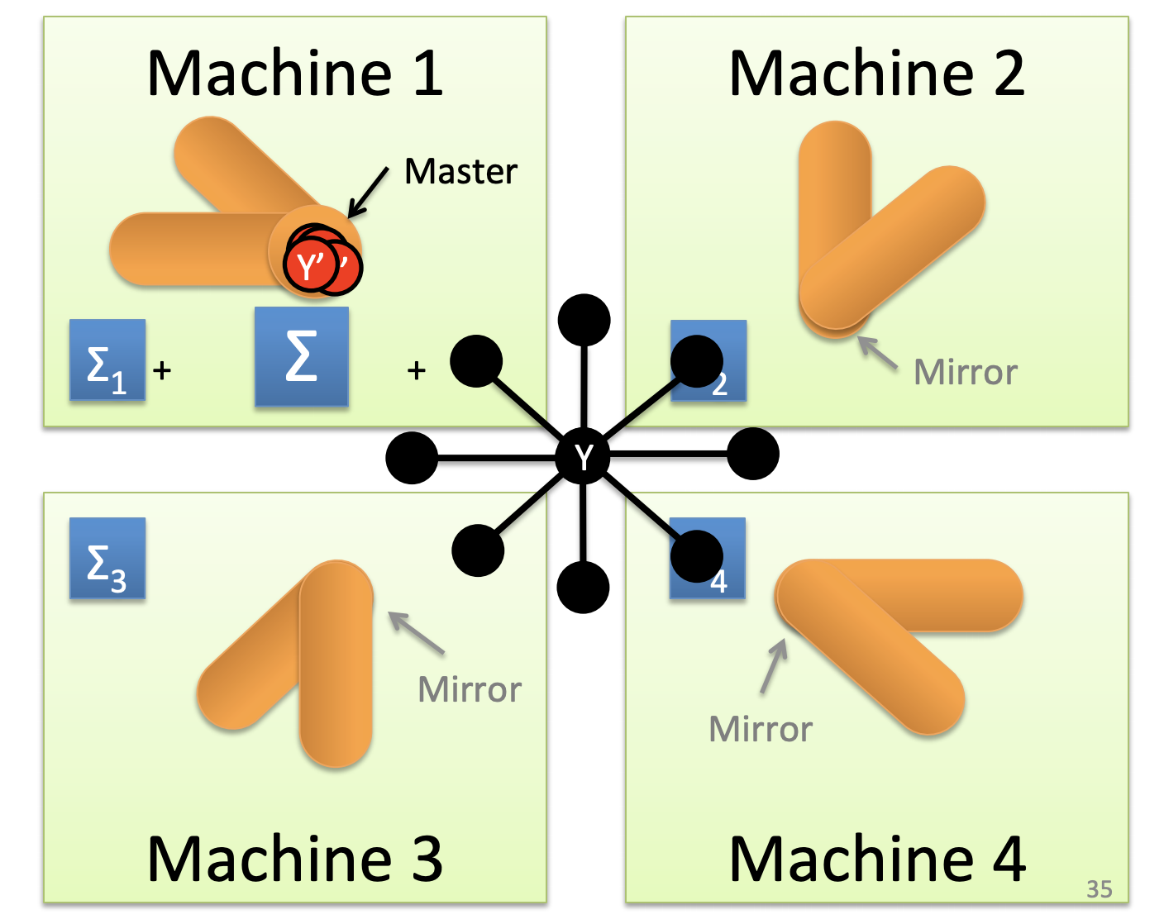
Vertex Cut
Allows vertices to span machines

Slide 26
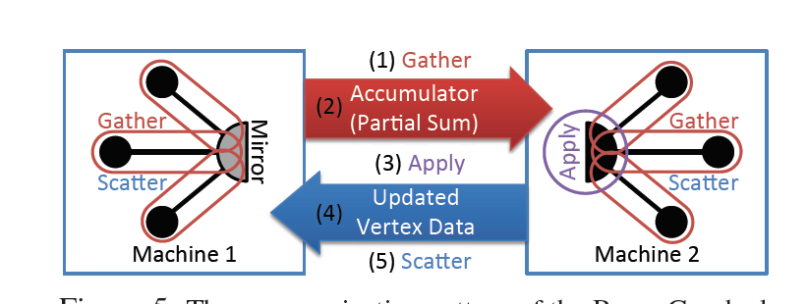
Vertex Cut
Allows vertices to span machines

Slide 27
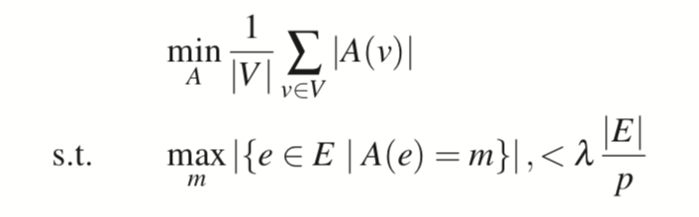
Vertex Cut
Evenly assigns edges to machines
Objective: Balanced p-way vertex-cut:
Notes:
Lambda is called the imbalance factor
A means assignment - the number of machines that contains the vertex (replicas).
The bottom left means the maximum edges in one machine.

Slide 28
Vertex Cut
Would cutting vertex create more communication and storage overhead
NO!
Theorem: For a given edge-cut with g ghosts, any vertex cut along the same partition boundary has strictly fewer than g mirrors.
Starting from 2-way - a bipartite graph
The number of ghosts = The number of vertice in the cut edges
Delete edges by removing a vertex - creating a mirror on the other machine
Delete all edges by removing at most |V| - 1 vertice - a single vertex cannot form an edge
Induction
Notes:
Lambda is called the imbalance factor

Slide 29
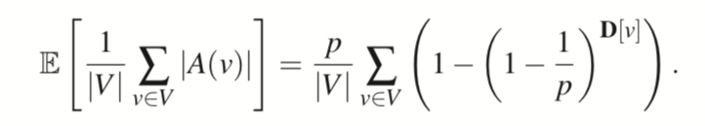
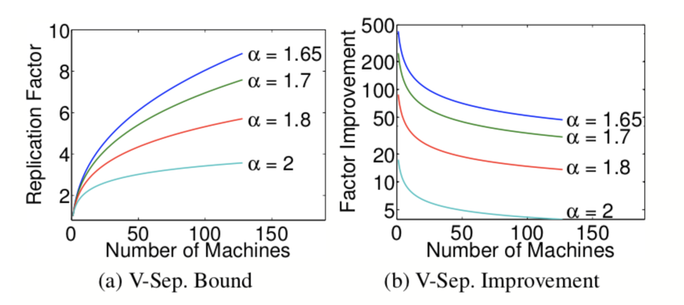
Randomized Vertex Cut
Randomized vertex-cut. Edges are randomly placed.
Good expectation for node replicas.
In the contrast, the expectation of random edge-cuts is |E|(1 - 1/p).
Notes:
D[v] denotes the degree of vertex v.

Slide 30
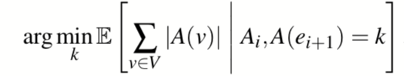
Greedy Vertex Cut
Greedy vertex-cut using sequential greedy heuristics.
Edge placement rules for a new edge (u, v)
If A(u) and A(v) intersect, then the edge should be assigned to a machine in the intersection.
If A(u) and A(v) are not empty and do not intersect, then the edge should be assigned to one of the machines from the vertex with the most unassigned edges. (Why?)
If only one of the two vertices has been assigned, then choose a machine from the assigned vertex.
If neither vertex has been assigned, then assign the edge to the least loaded machine.
Notes:
A(e_{i+1}) means the assignment of the new edge. We would like to greedly choose the assignment such that the mirrors are the minimum.
Why the one with the more unassigned edges?

Slide 31
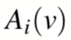
Greedy Vertex Cut
Greedy vertex-cut with coordinated implementation.
Values of maintained in distributed table.
Each machine updates the table periodically.
Use local cache to reduce communication.
Greedy vertex-cut with oblivious implementation.
Each machine runs heuristic indepently with no communication.

Slide 32
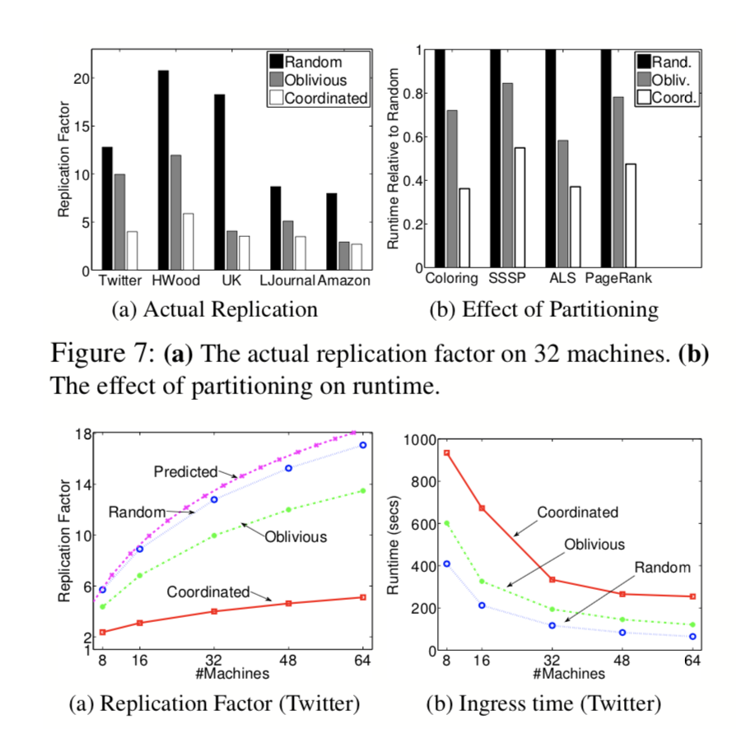
Distributed Graph Placement - Evaluation
Greedy outperforms random vertex-cut in all cases.

Slide 33
Imbalance
Characterize the dependence on α and the relationship between fan-in and fan-out
Use the Pregel, GraphLab, and PowerGraph abstractions to run PageRank on five synthetically constructed power-law graphs
Computational Imbalance
Proportional to out-degree in the Pregel abstraction
Proportional to in-degree in the GraphLab abstraction
PowerGraph distributes the computation of individual vertex-programs over multiple machines
Communication Imbalance
Proportional to edge-cuts in GraphLab and Pregel
Proportional to mirrors in PowerGraph
Notes:
The graphs were constructed by randomly sampling the out degree of each vertex from a Zipf distribution and then adding Out edges such that the in-degree of each vertex is nearly identical. We then inverted each graph to obtain the corresponding Powerlaw Fan in graph.

Slide 34
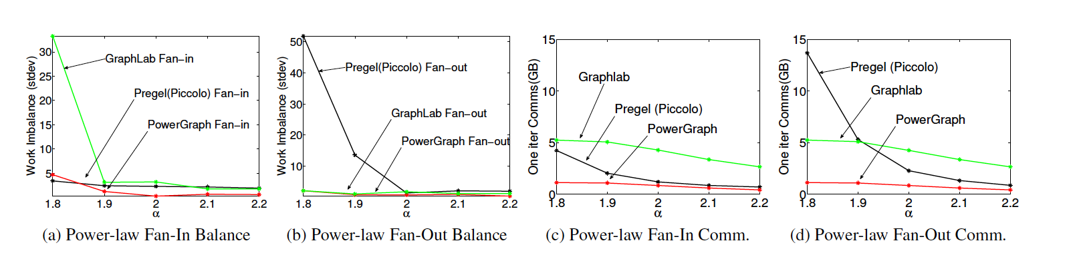
Imbalance
Computational Imbalance and Communication Imbalance
Notes:
Synchronization in graphlab and powergraph are invariant to the edge direction.

Slide 35
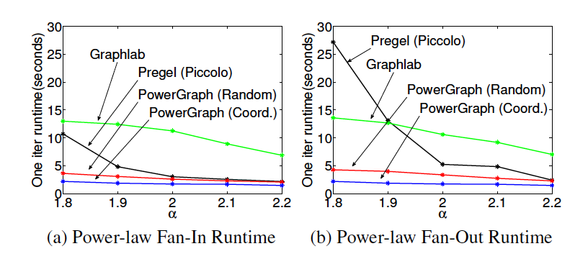
Imbalance
Runtime Comparison

Slide 36
Implementation
Three modes:
Bulk Synchronous (600 LoC)
Asynchronous (900 LoC)
Asynchronous Serializable (1600 LoC)
Fault Tolerance: saving snapshots of the data-graph
Synchronous engine constructs the snapshot between super-steps
Asynchronous engine suspends execution to construct the snapshot
Checkpoint overhead is typically a few seconds
Notes:
Asynchronous Serializable: which guarantees serializability of all vertex-programs (equivalent to “edge consistency” in GraphLab)

Slide 37
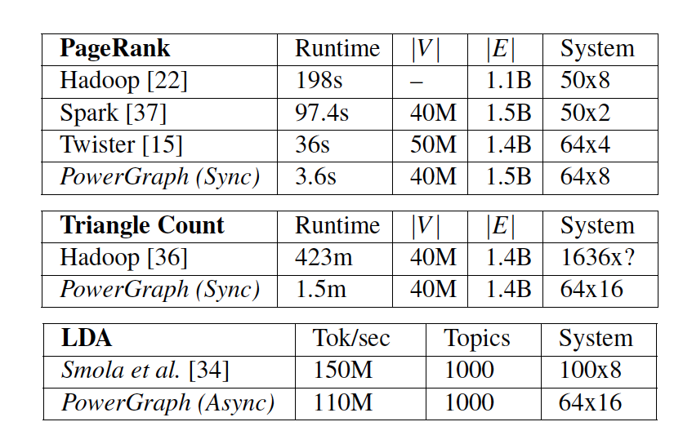
Evaluation
Notes:
For LDA, the state-of-the-art solution is a heavily optimized
system designed for this specific task by Smola et al. [34].
In contrast, PowerGraph is able to achieve comparable
performance using only 200 lines of user code.

Slide 38
GraphX: Graph Processing in a Distributed Dataflow Framework
Authors: Josepth E. Gonzalez, Reynold S. Xin, Ankur Dave, Daniel Crankshaw, Michael J. Franklin, Ion Stocia
Some of the slides come from Josepth E. Gonzalez, OSDI 14

Slide 39


Specialized graph processing systems
General purpose dataflow framework
vs.
High complexity and unnecessary data replacement
Naive fault tolerance
Do not enjoy broad support of distributed dataflow frameworks
Hard to implement iterative graph algorithms
Less optimization on graph computation

Slide 40
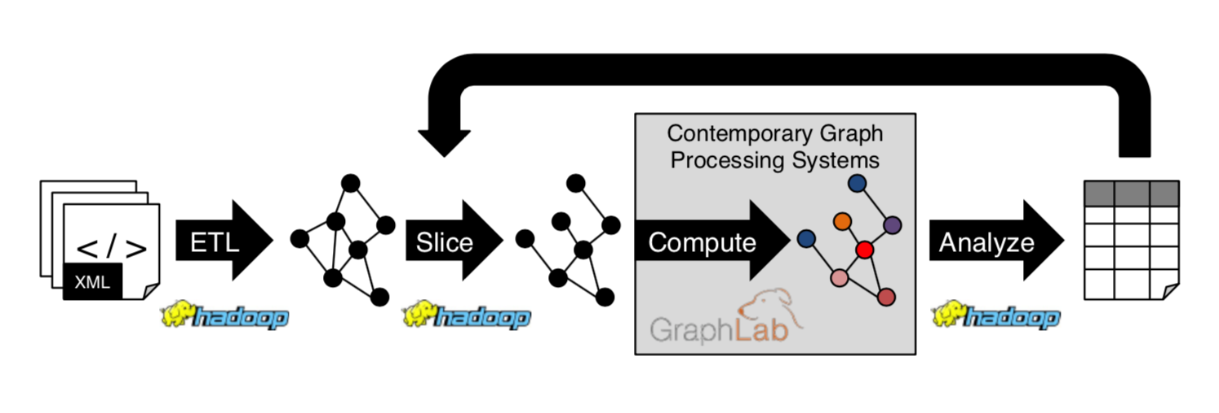
Difficult to use and inefficient
Users must learn, deploy and manage multiple systems
Expensive data movement and duplication across systems

Slide 41
GraphX unifies computation on tables and graphs and enables a single system to address the entire analytic pipeline

Slide 42
How can we naturally express and efficiently execute graph computation in a general purpose dataflow framework?
Representation + Optimization

Slide 43
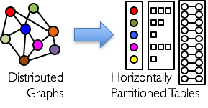
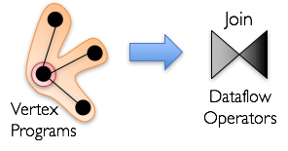
Representation

Slide 44
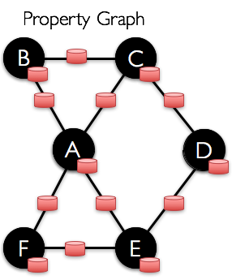
Data Model: Property Graph
Associate user-defined properties with each vertex and edge.
Properties could be:
Metadata (e.g. user profiles)
Program state (e.g. PageRank value)

Slide 45
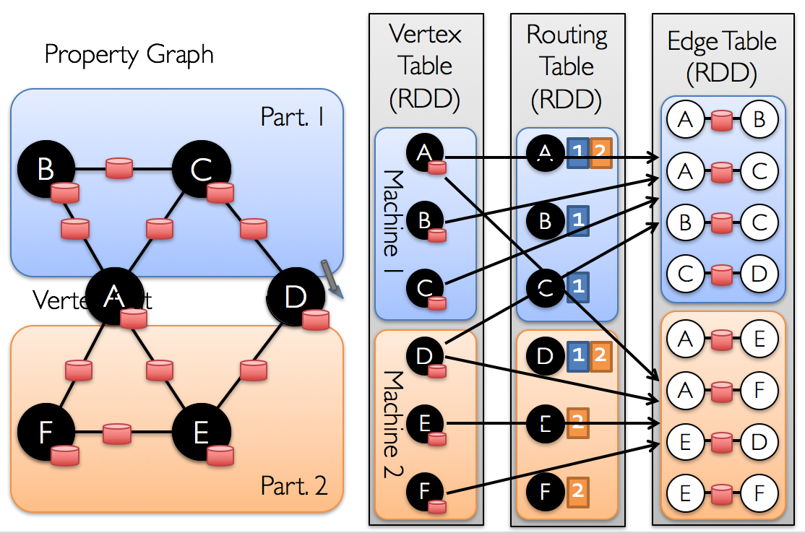
Data Model: Property Graphs as Tables
Notes:
Vertex properties keyed by vertex identifier
Edge properties keyed by source and destination vertex identifiers
Mirror caching of corresponding vertex and properties in edge table

Slide 46
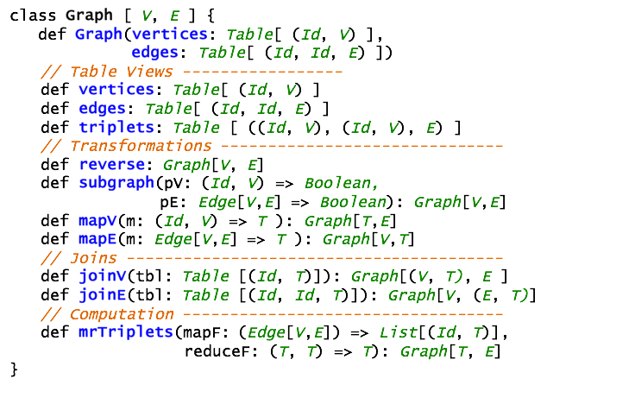
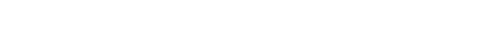
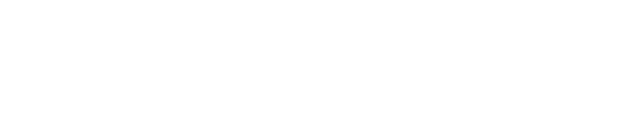
Graph Operators
capture the Gather-Apply-Scatter pattern from
specialized graph processing systems

Slide 47
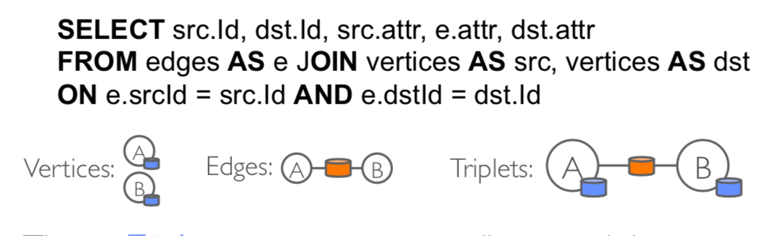
Triplets
The triplets operator joins vertices and edges.

Slide 48
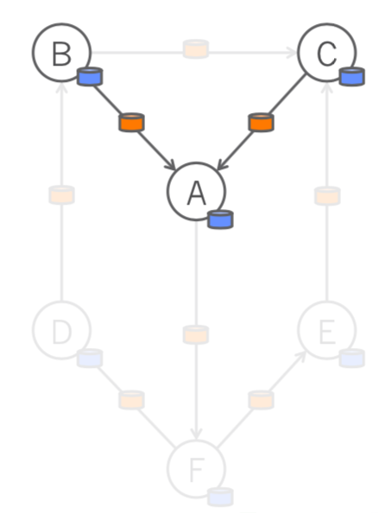
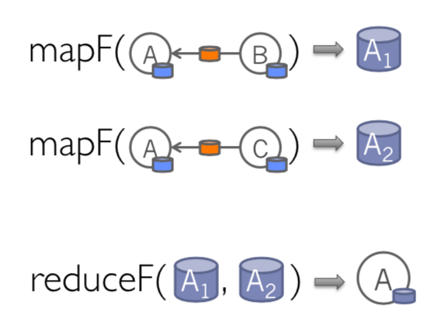
MapReduce Triplets
The mrTriplets operator collect information about the neighborhood of each vertex.

Slide 49
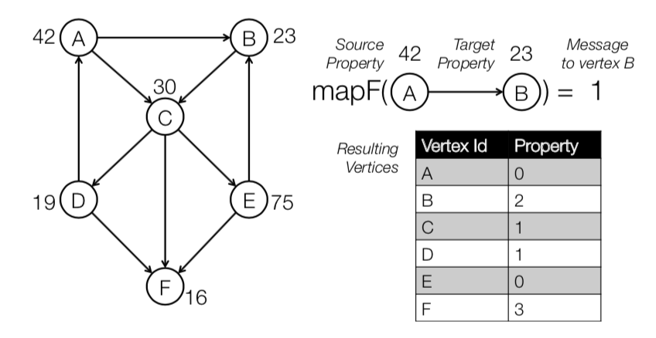
MapReduce Triplets Example
Use mrTriplets to compute the number of older followers of each person

Slide 50
Graph Computation as Dataflow Operators
Gather | Group-by (Reduce)
Apply | Map
Scatter | Join
mrtriplets
triplets
Notes:
Group-by: triplets are grouped by source or dest vertices to construct neighborhood of each vertex and compute aggregates
Use a map operation to apply the message sum to update vertex properties
Join: vertex and edge properties are joined to form the triplets view; scatters new vertex property to all adjacent vertices

Slide 51
Optimization
Join site selection using routing tables
Incremental updates for triplets view
Automatic join elimination
Index scanning for active edges
Index and routing table reuse
Lineage based fault tolerance

Slide 52
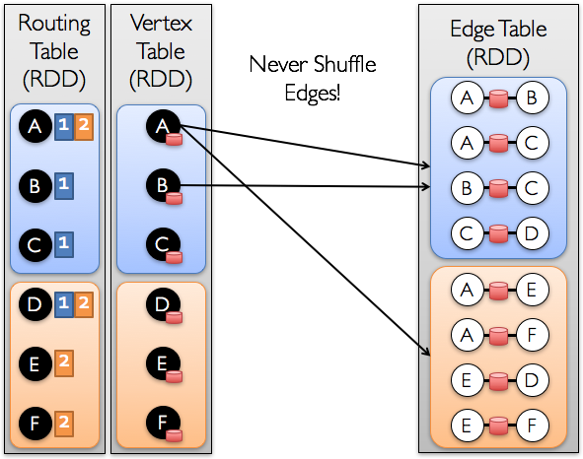
Join Site Selection using Routing Tables
GraphX maintains a routing table encoding the edge partitions for each vertex
Optimize distributed joins
Enable flexible edge placement
Notes:
Optimize distributed joins
we never shuffle edges and this can be a big win since the edge table is often orders of magnitude larger than the vertex table.

Slide 53
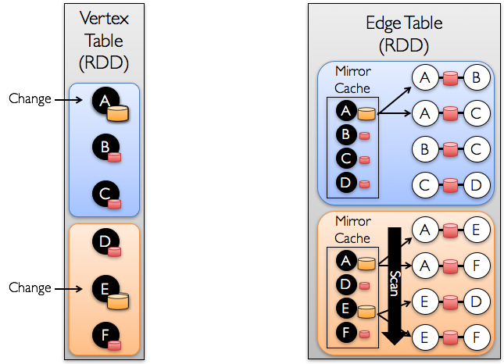
Incremental Updates for Triplets View
Re-route only the changed vertices
Reuse local mirrored values of the unchanged vertices
Triplets are not reconstructed from scratch every iteration

Slide 54
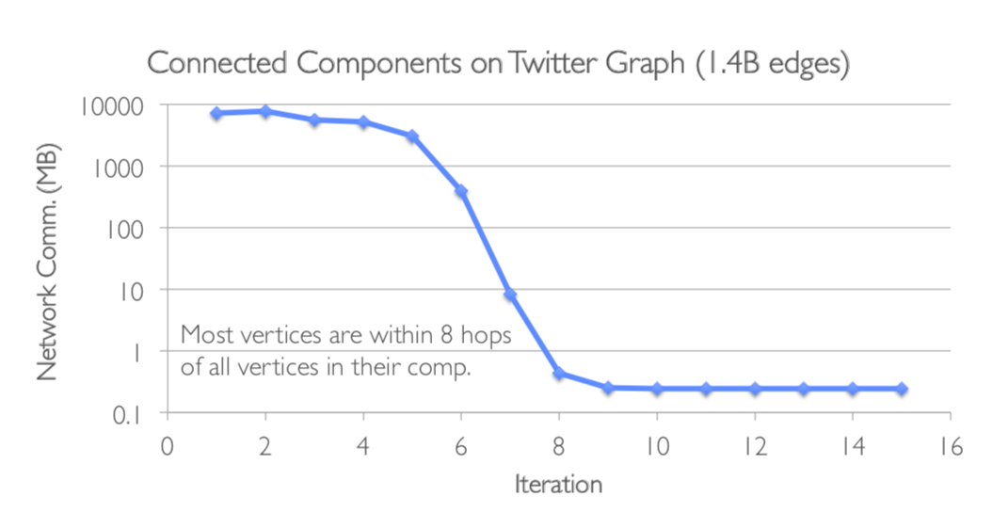
Incremental Updates for Triplets View

Slide 55
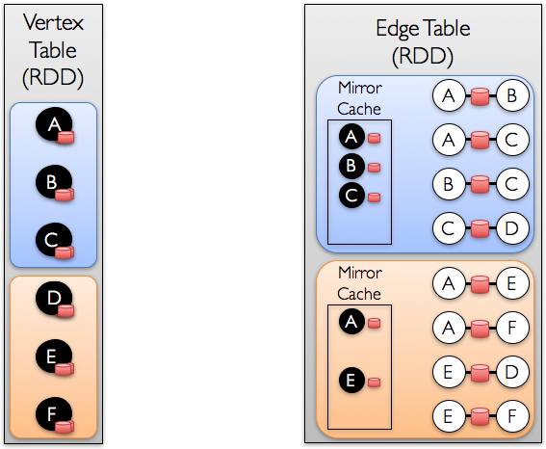
Automatic Join Elimination
Operations on triplets often access no more than one of vertex properties
Identify and bypass joins for unused triplet fields
Notes:
Pagerank - dont need destination vertex property

Slide 56

Automatic Join Elimination
dsdfsdklsjdflkjs
Notes:
Three way join to two way join

Slide 57

Index Scanning for Active Edges
Edges within a partition are clustered by source vertex id and hash-indexed by target vertex id
Switch from sequential scan to clustered index scan as algorithm converges
dsdfsdklsjdflkjs
Notes:
Algorithm converge, working set shrink - do not need operations on converged vertices
Restrict the graph so that it only contains working set
Filter triplets based on source vertex id

Slide 58

Reuse Index and table
Reduce memory overhead and enable faster joins
Notes:
Derived vertex and edge collections share indices
Vertex collections sharing the same index can be joined without index lookup

Slide 59
Lineage based fault tolerance
Exploits Spark lineage to recover in parallel
Avoid expensive checkpoints thanks to lineage graph
Spark-supported optional in-memory distributed replication
Notes:
Replication to reduce recomputation

Slide 60

Evaluation
GraphX has comparable performance with specialized graph-processing systems.

Slide 61
Thanks!

Slide 62
Discussion
Fault Tolerance: checkpointing?
Vertex replication
Persistent Storage
Greedy edge-cut strategy?
Time-evolving graph?
Notes:
Asynchronous Serializable: which guarantees serializability of all vertex-programs (equivalent to “edge consistency” in GraphLab)

